Slide 1




Building and Evaluating Theories in Software Engineering
Daniel Méndez
Blekinge Institute of Technology, Sweden
fortiss GmbH, Germany
www.mendezfe.org
mendezfe

Slide 2

Ground rule
Whenever you have questions / remarks, please don’t ask , but
share them with the whole group.

Slide 3
Frequently encountered prejudice
“Our inability to carry out truly scientific experiments and surveys [...] will yield anecdotes of limited value. Empirical studies should only be used to confirm what works in theory […]”
“Only quantitative data is real data.”

Slide 4


At the same time, we often see studies like this
Research Question: Which car has the best driving performance?
H_0: There is no difference.
20 people without a driving licence participate. They are taught to drive in a lecture of 2 hours.
Results: The BMW is significantly better than the Volvo (p<0.01)
Empirical research is more than simply applying statistical equations in search for universal “truth”
Adopted from: Dag I.K. Sjøberg, Keynote at the International Conference on Product-Focused SW Process Improvement 2016, Trondheim, Norway.
Image sources: Company websites

Slide 5
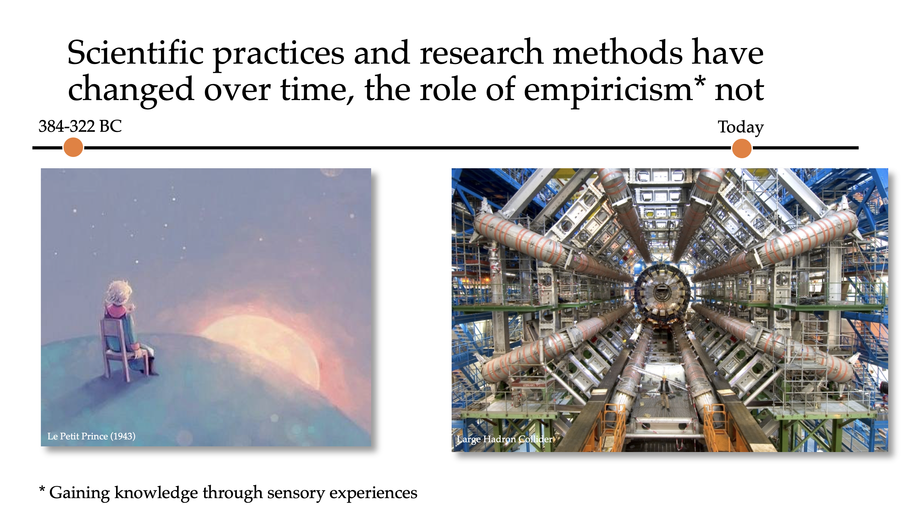
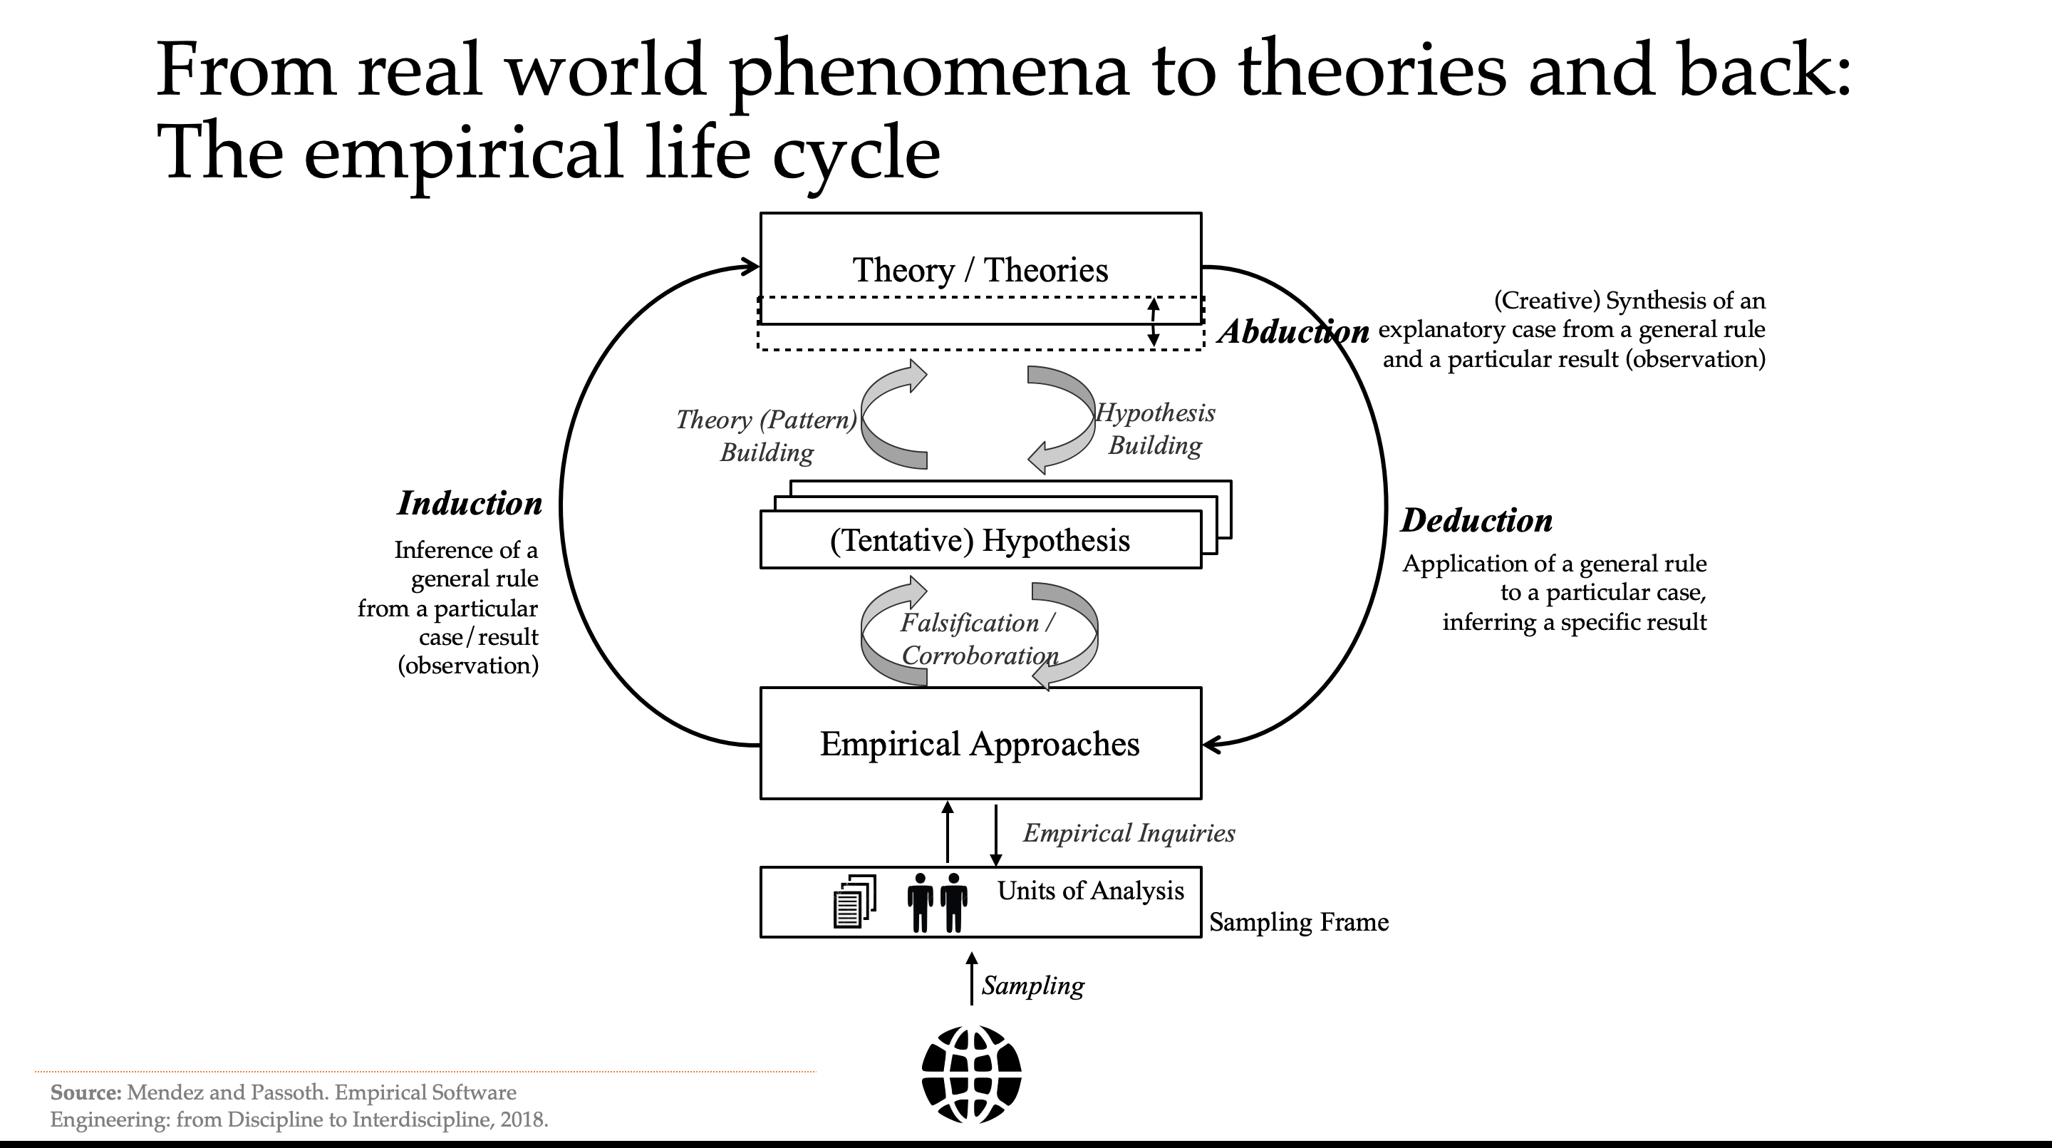
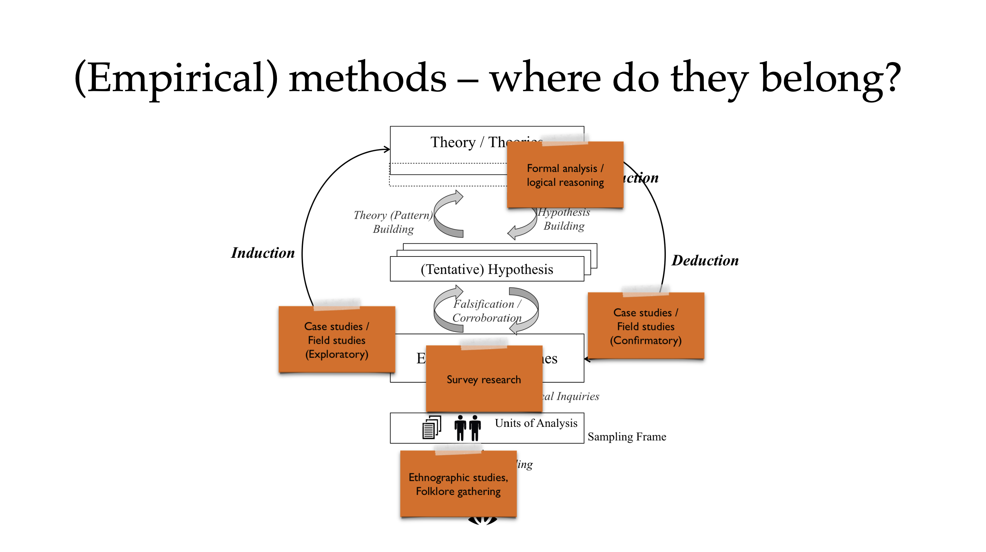
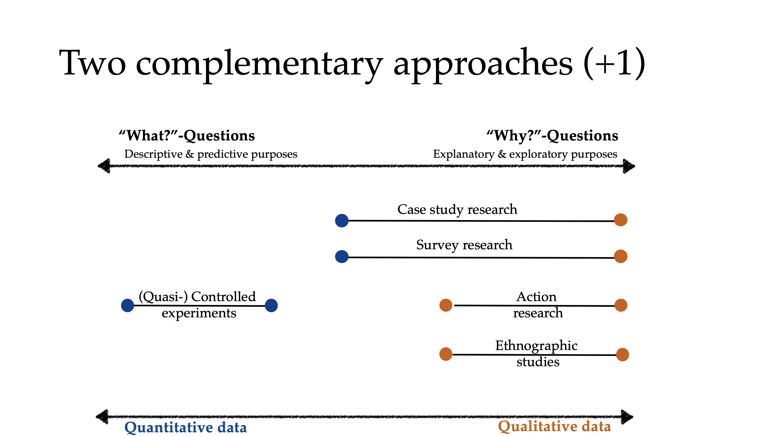
Key Takeaways
Empirical research is the backbone of every scientific discipline.
Theory building and evaluation allow us to move forward from paradigmatic stage of an engineering discipline to a scientific one.
Every research method has its place in a larger picture.
Qualitative and quantitative research have complementary purposes, strengths, and limitations in building and evaluating theories.

Slide 6

Theory Building in Software Engineering
Science and Theories in a Nutshell
… where we will briefly talk about the general notion of theories
State of Evidence in Software Engineering
… where we will see why theory building is so important to our field
Research Methods in Software Engineering
… where we will put research methods in a larger (philosophical) picture
Qualitative “vs” quantitative research
… where we will briefly discuss different research approaches

Slide 7
Theory Building in Software Engineering
Science and Theories in a Nutshell
… where we will briefly talk about the general notion of theories
State of Evidence in Software Engineering
… where we will see why theory building is so important to our field
Research Methods in Software Engineering
… where we will put research methods in a larger (philosophical) picture
Qualitative “vs” quantitative research
… where we will briefly discuss different research approaches

Slide 8
Let’s start step by step….
What is scientific practice?
-- What do you think? --

Slide 9
“Science” wasn’t built in a day…
Science is understood as the human undertaking for the search of knowledge (through systematic application of scientific methods)
Needs to be considered in a historical context
Increased understanding of scientific practice (and what science eventually is)
384-322 BC
…
1561-1626
…
1694-1778
1724-1804
…
1896-1980
1902-1994
…
Aristoteles
Bacon
Voltaire
Kant
Piaget
Popper
Search for laws and reasoning for phenomena
Understanding the nature of phenomena
Emancipation from gods and beliefs
Era of constructivism
Progress of knowledge of nature (reality)
Draw benefits from knowledge growth
Falsification as demarcation criterion
Birth of null hypothesis testing
System of Epistemology (theory of knowledge)

Slide 10

Scientific practices and research methods have changed over time, the role of empiricism* not
384-322 BC
Today
Le Petit Prince (1943)
Large Hadron Collider
* Gaining knowledge through sensory experiences

Slide 11
Scientific knowledge and practice
Scientific knowledge is the portrait of our understanding of reality (via scientific theories).
Necessary postulates for scientific practice:
There are certain rules, principles, and norms for scientific practices
Rationalism: Reasoning by argument / logical inference / mathematical proof
Empiricism: Reasoning by sensory experiences (case studies, experiments,…)
There is nothing absolute about truth
There is a scientific community to judge about the quality of empirical studies
Although empirical observations may be faulty, it is possible (in the long run) to make reliable observations and to falsify incorrect statements about reality

Slide 12
But what is a Scientific Theory?
-- What do you think? --

Slide 13
Theories (generally speaking)
A theory is a belief that there is a pattern in phenomena.
Examples (following this general notion of theory):
“Vaccinations lead to autism”
“Global warming is a hoax by ecologists to harm the industry”
“Earth is flat”
…
Are these theories scientific?
No: Speculations based on imagination, hopes and fears, and resulting in opinions that often cannot be refuted (i.e. logical fallacies)

Slide 14
Scientific Theories
A scientific theory is a belief that there is a pattern in phenomena while having survived
tests against sensory experiences
criticism by critical peers
Note: Addresses so-called Demarcation Problem to distinguish science from non-science (as per introduction by K. Popper)
1. Tests
Experiments, simulations, …
Replications
2. Criticism
Peer reviews / acceptance in the community
Corroborations / extensions with further theories
In scope of empirical research methods

Slide 15
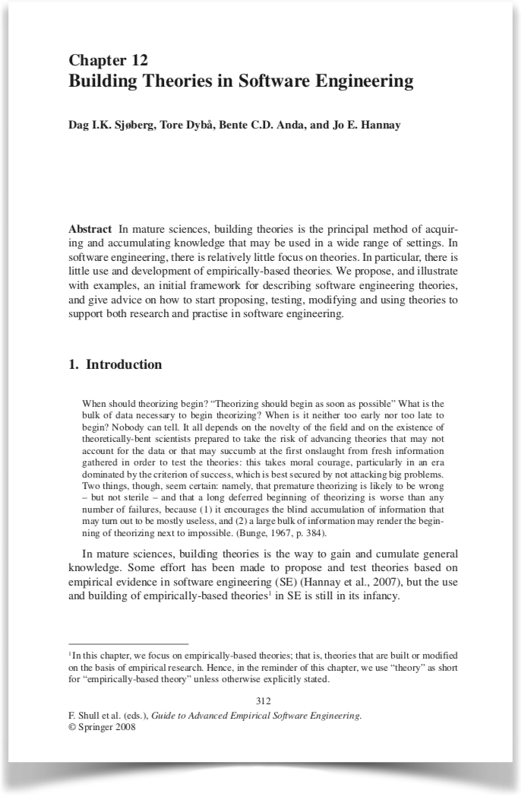

“There is no universally agreed upon definition of the concept of an empirically-based theory [in Software Engineering], nor is there any uniform terminology for describing theories.”
Approach by characteristics
Source: Sjøberg, D., Dybå, T., Anda, B., Hannay, J. Building Theories in Software Engineering, 2010.

Slide 16
Scientific Theories have…
Note: Design Science Theories A theory about artefacts in a context
[Artefact specification] X [Context assumption] → [Effect]
… a purpose:
 | Analytical | Explanatory | Predictive | Explanatory & Predictive
Scope | Descriptions and conceptualisation, including taxonomies, classifications, and ontologies - What is? | Identification of phenomena by identifying causes, mechanisms or reasons - Why is? | Prediction of what will happen in the future - What will happen? | Prediction of what will happen in the future and explanation - What will happen and why?
… quality criteria:
Testability
Empirical support / (high) level of confidence
Explanatory power
Usefulness to researchers and / or practitioners
…
Note: “Law” versus “Theory” A law is a descriptive theory without explanations (i.e. an analytical theory)
Adapted from: Sjøberg, D., Dybå, T., Anda, B., Hannay, J. Building Theories in Software Engineering, 2010.

Slide 17
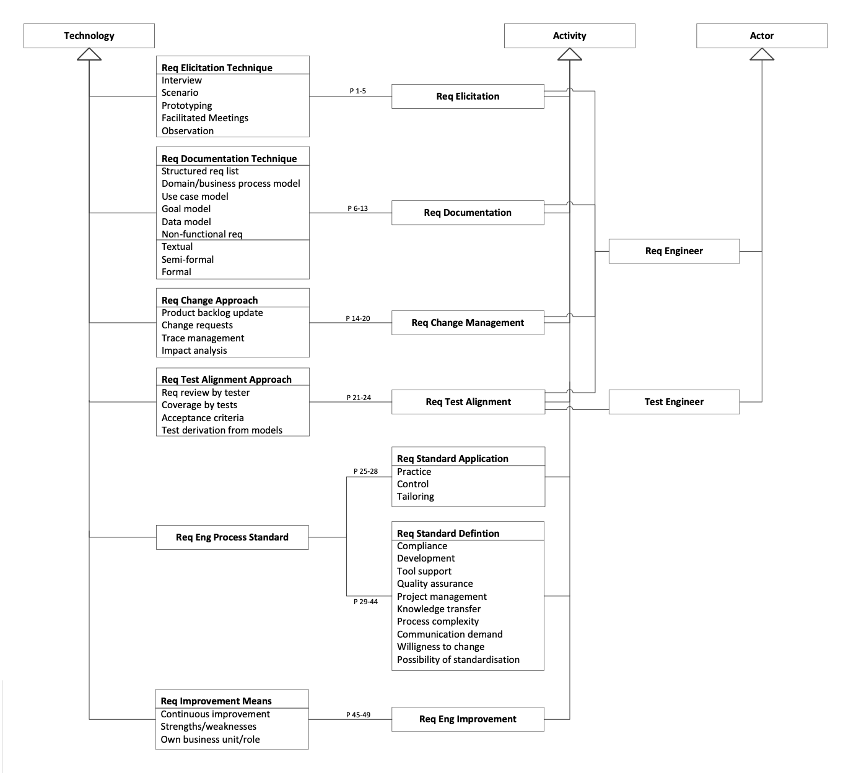

Exemplary framework for describing theories in Software Engineering
Example
Constructs: What are the basic elements? (Actors, technologies, activities, system entities, context factors)
Propositions: How do the constructs interact?
Explanations: Why are the propositions as specified?
Scope: What is the universe of discourse in which the theory is applicable?
Proposition:
“Structured requirements lists are documented textually in free form or textually with constraints.”
Explanation and Scope:
“Free-form and constraint textual requirements are sufficient for many contexts such as in agile projects where they only act as reminders for further conversations.”
Source (framework): Sjøberg, D., Dybå, T., Anda, B., Hannay, J. Building Theories in Software Engineering, 2010.
Source (example): Wagner, Mendez et al. Status Quo in Requirements Engineering: A Theory and a Global Family of Surveys, TOSEM 2018.

Slide 18
Theories and hypotheses
Note: We don’t “test theories”, but their consequences via hypotheses (i.e. testable propositions)
Scientific theory
“[…] based on hypotheses tested and verified multiple times by detached researchers” (J. Bortz and N. Döring, 2003)
Hypothesis
“[…] a statement that proposes a possible explanation to some phenomenon or event” (L. Given, 2008)
Grounded in theory, testable and falsifiable
Often quantified and written as a conditional statement
Theory / Theories
Theory (Pattern) Building
Hypothesis Building
(Tentative) Hypothesis
Falsification / Corroboration
Empirical Approaches
If cause/assumption (independent variables)
then (=>) consequence (dependent variables)

Slide 19
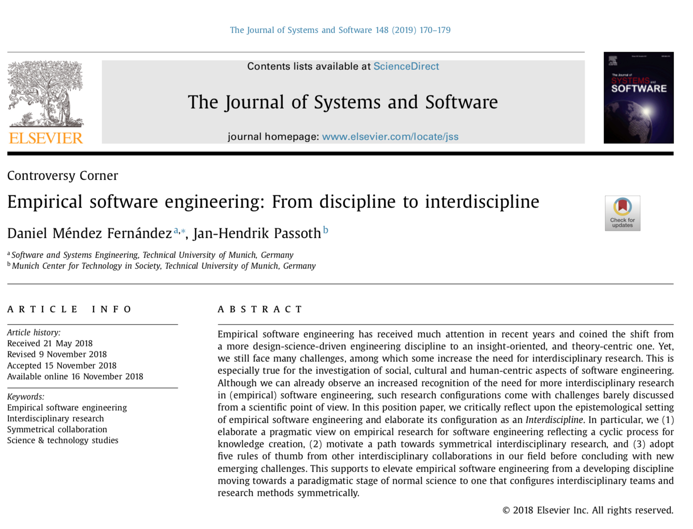
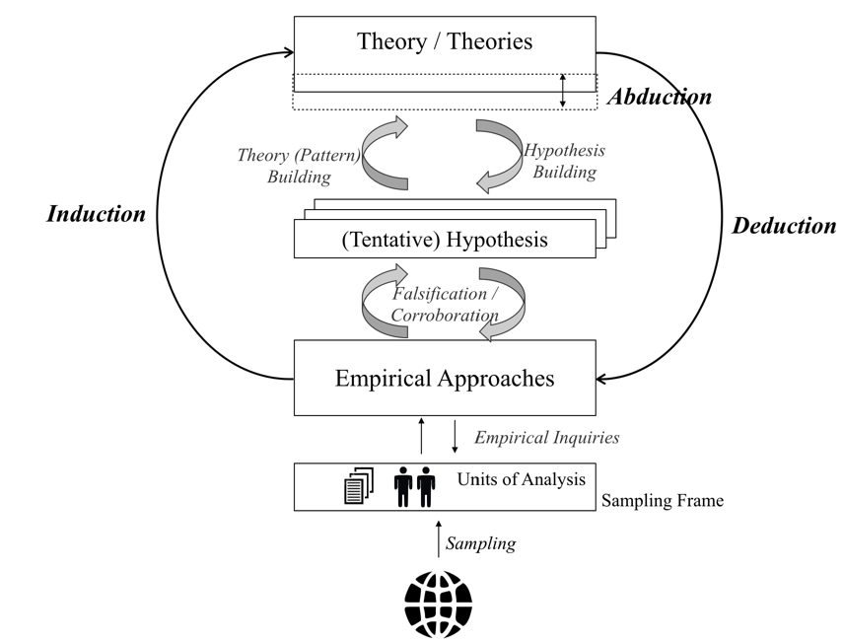




From real world phenomena to theories and back: The empirical life cycle
Further reading and outlook
Theory / Theories
Abduction
(Creative) Synthesis of an explanatory case from a general rule and a particular result (observation)
Theory (Pattern) Building
Hypothesis Building
Induction
Deduction
Inference of a general rule from a particular case/result (observation)
(Tentative) Hypothesis
Application of a general rule to a particular case, inferring a specific result
Falsification / Corroboration
Empirical Approaches
Preprint: https://arxiv.org/abs/1805.08302
Empirical Inquiries
Units of Analysis
Epistemological setting of Empirical Software Engineering
Theory building and evaluation
Challenges in Empirical Software Engineering
Sampling Frame
Sampling
Source: Mendez and Passoth. Empirical Software Engineering: from Discipline to Interdiscipline, 2018.

Slide 20
Theory Building in Software Engineering
Science and Theories in a Nutshell
… where we will briefly talk about the general notion of theories
State of Evidence in Software Engineering
… where we will see why theory building is so important to our field
Research Methods in Software Engineering
… where we will put research methods in a larger (philosophical) picture
Qualitative “vs” quantitative research
… where we will briefly discuss different research approaches

Slide 21
What are exemplary scientific Software Engineering Theories?
-- Which ones do you know? --

Slide 22

Scientific Theories in Software Engineering
Transferred verbatim from other disciplines (i.e. not adopted)
Example: Theory of Gatekeeping
Isolated and vague (i.e. universal)
Example: “Frontloading efforts decreases overall development costs”
Not backed by evidence (i.e. non-scientific conventional wisdom)
Example: “GoTo statements are harmful”
Disclaimer: Symbolic statement, might be slightly over exaggerated
Image Source: https://www.worldwildlife.org/habitats/deserts

Slide 23
Current state of evidence in Software Engineering
“[…] judging a theory by assessing the number, faith, and vocal energy of its supporters […] basic political credo of contemporary religious maniacs”
— Imre Lakatos, 1970
* Addressing the situation in the quantum mechanics research community, an analogy

Slide 24
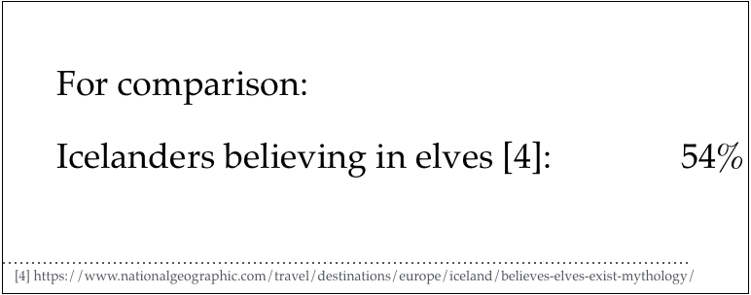

Example: Goal-oriented RE
Papers published [1]: 966
Papers including a case study [1]: 131
Studies involving practitioners [2]: 20
Practitioners actually using GORE [3]: ~ 5%
[1] Horkoff et al. Goal-Oriented Requirements Engineering: A Systematic Literature Map, 2016
[2] Mavin, et al. Does Goal-Oriented Requirements Engineering Achieve its Goal?, 2017
[3] Mendez et al. Naming the Pain in Requirements Engineering Initiative – www.napire.org

Slide 25
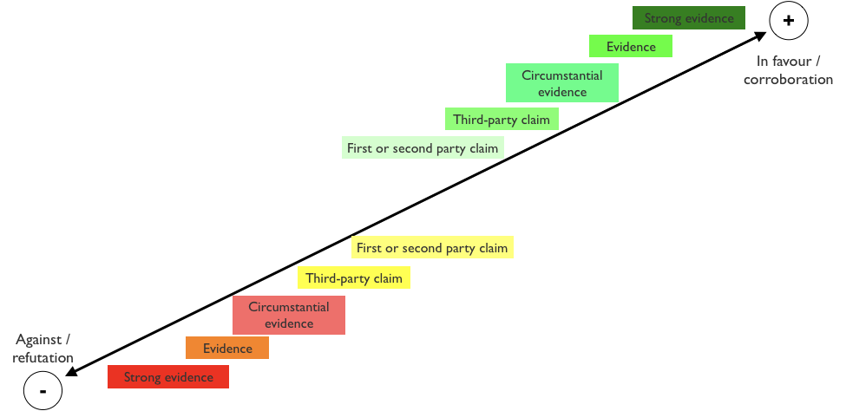
Current state of evidence in SE
Available studies often…
… remain isolated
… discuss little (to no) relation to existing evidence
… strengthen confidence on own hopes (and don’t report anything around)
… don’t report negative results
In most cases, we are here
Source (levels of evidence): Wohlin. An Evidence Profile for Software Engineering Research and Practice, 2013.

Slide 26
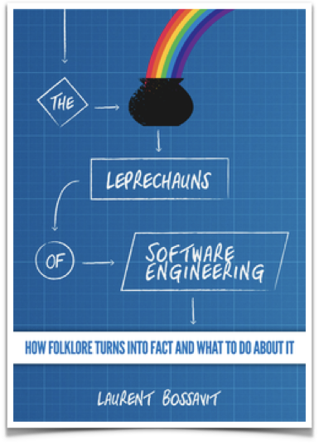
Conventional Wisdom in SE
“Leprechauns”: Folklore turned into facts
Emerge from times where claims by authorities were treated as “facts”
Reasons manifold:
Lack of empirical awareness
Neglecting particularities of practical contexts
Neglecting relation to existing evidence
No proper citations (one side of the medal, over-conclusions, etc.)
Lack of data
…

Slide 27
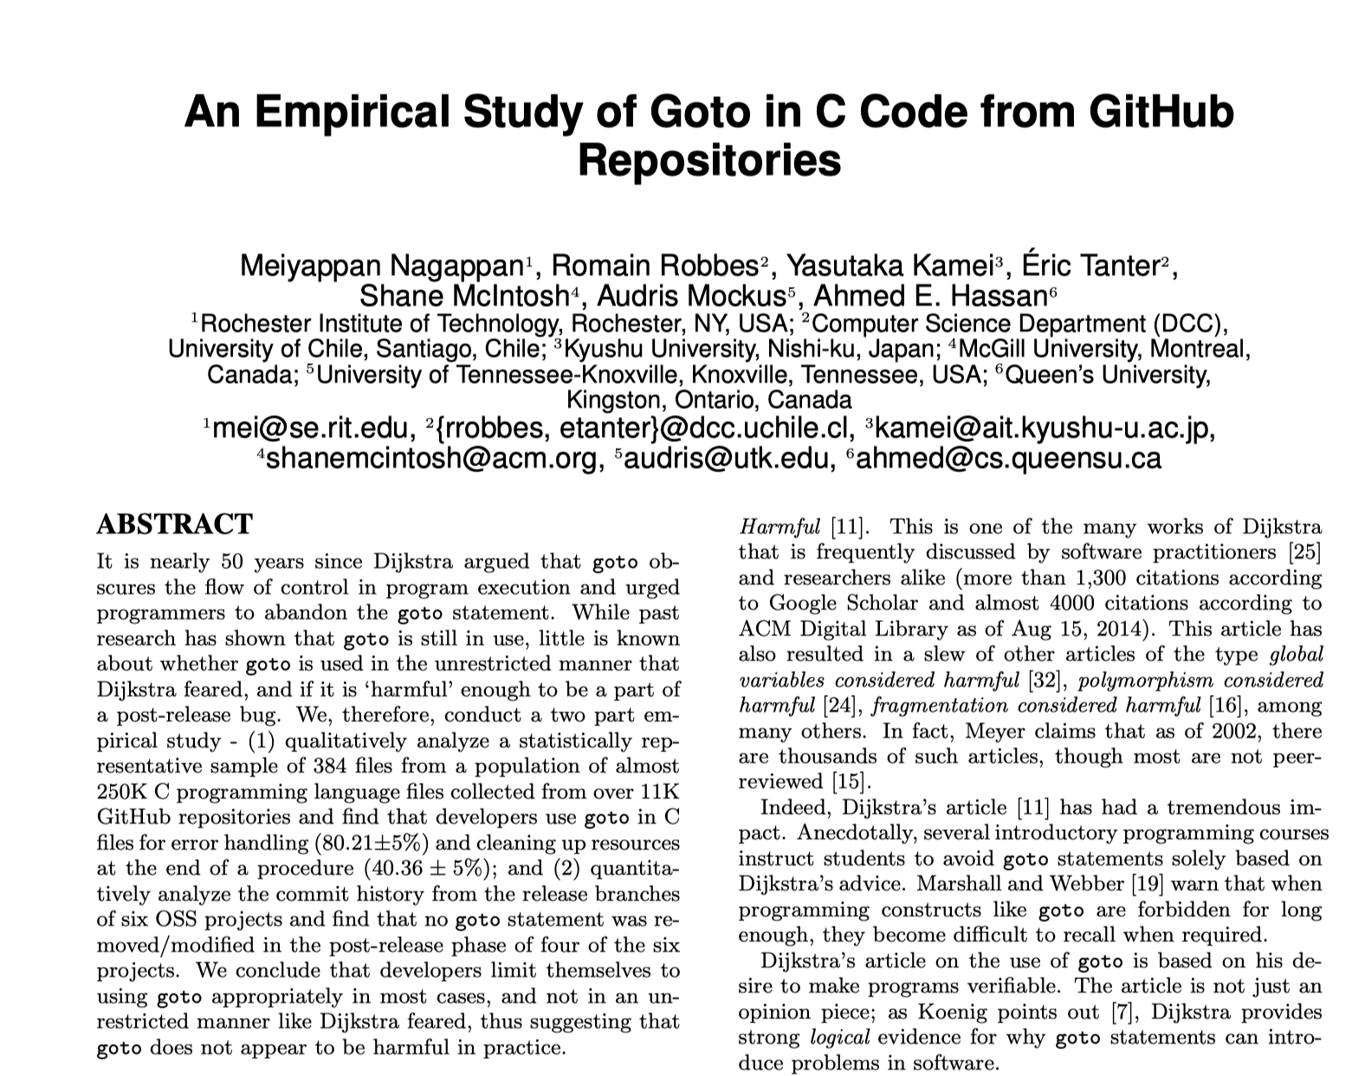
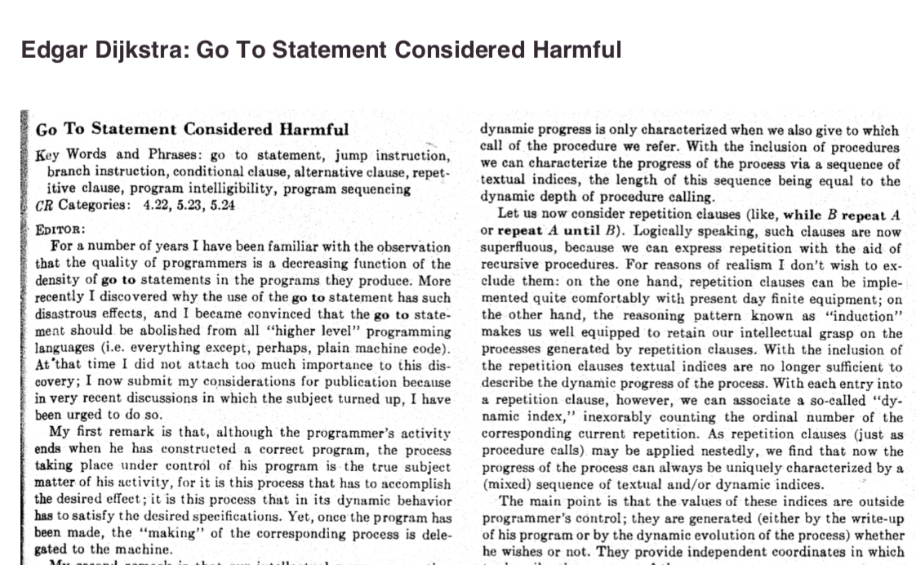
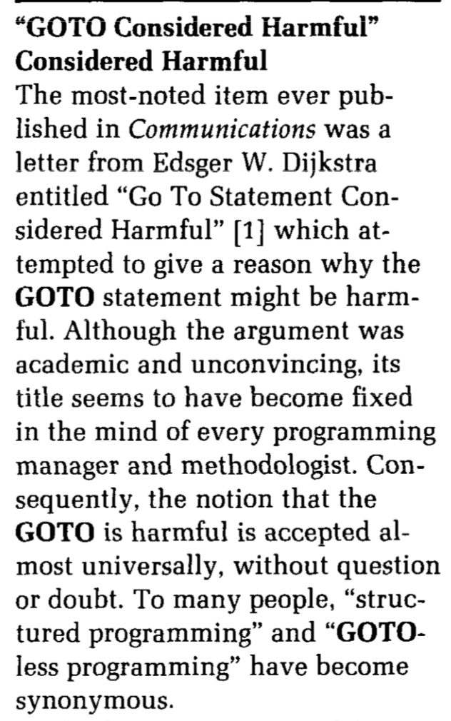
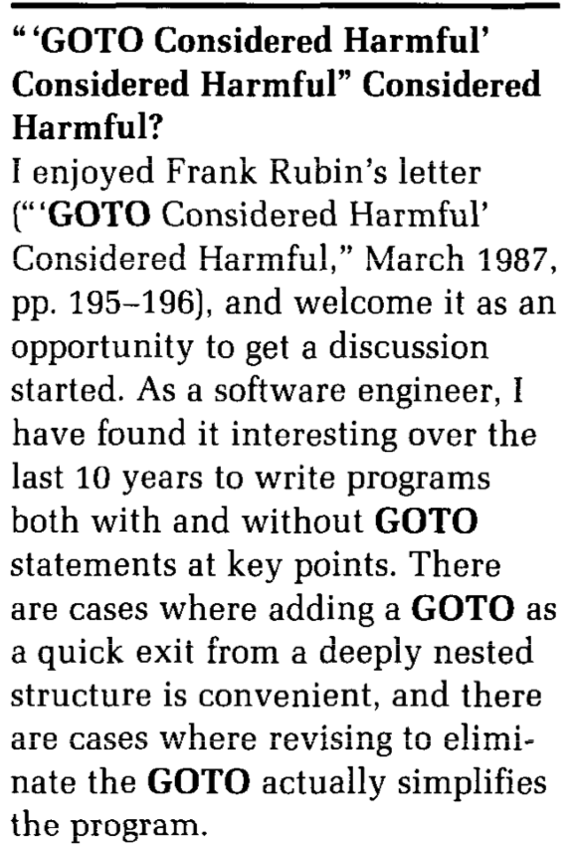
Exemplary “leprechaun”: Go To statements considered harmful
1968
2015
1969
1987
“We conclude that developers limit themselves to using goto appropriately, [not] like Dijkstra feared, [thus] goto does not appear to be harmful in practice.”
Public exchange based on reasoning by argument (rationalist arguments)...
… finally challenged by one single empirical study.
[1] Edsger Dijkstra . Go To Statement Considered Harmful. Communications of the ACM, 1968.
[2] Frank Rubin. ”GOTO Considered Harmful" Considered Harmful. Communications of the ACM, 1969.
[3] Donald Moore et al. " 'GOTO Considered Harmful' Considered Harmful" Considered Harmful?" Communications of the ACM, 1987.
[4] Nagappan et al. An empirical study of goto in C code from GitHub repositories, 2015.

Slide 28
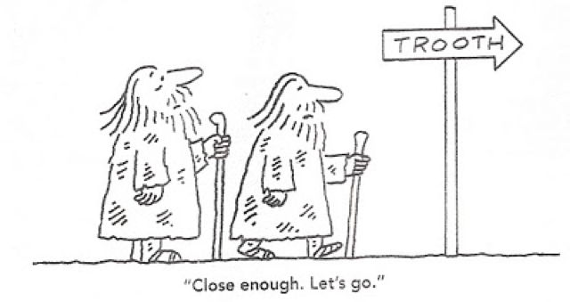
Takeaway
The current state of evidence in Software Engineering is still weak
Practical relevance and impact?
Potential for transfer into practice and adoption?
Theory building and evaluation (i.e. empirical SE) are crucial
Reason about the discipline and social phenomena involved
Recognise and understand limits and effects of artefacts (technologies, techniques, processes, models, etc.) in their contexts

Slide 29
Theory Building in Software Engineering
Science and Theories in a Nutshell
… where we will briefly talk about the general notion of theories
State of Evidence in Software Engineering
… where we will see why theory building is so important to our field
Research Methods in Software Engineering
… where we will put research methods in a larger (philosophical) picture
Qualitative “vs” quantitative research
… where we will briefly discuss different research approaches

Slide 30

Recap: The empirical Lifecycle
Source: Mendez and Passoth. Empirical Software Engineering: from Discipline to Interdiscipline, 2018.

Slide 31
(Empirical) methods
Example: “Grounded Theory”
Each method…
…has a specific purpose
…relies on a specific data type
Purposes
Exploratory
Descriptive
Explanatory
Improving
Data Types
Qualitative
Quantitative
Descriptive, exploratory, or explanatory
Qualitative data

Slide 32
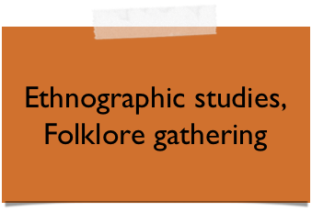
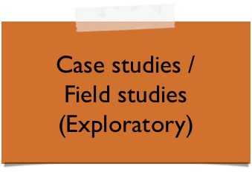
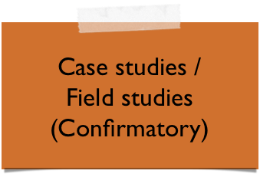
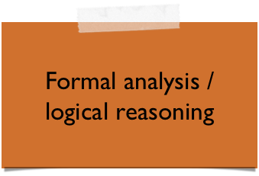

(Empirical) methods – where do they belong?

Slide 33
Which research method(s) to use in which situation?

Slide 34
There is no such thing as a universal way of scientific practice
Research method

Slide 35
Method selection depends on many non-trivial questions
Criteria for selecting methods
What is the purpose of the study? Exploratory? Descriptive? Explanatory? Improving?
What is the nature of the study? Inductive? Deductive?
What is the relation to existing evidence? Building a new theory? “Testing” existing theory?
What is the nature of the questions we ask? What-questions? Why-questions?
What is the nature of the environment? Controlled environments? Realistic environments?
What is the necessary sample? Population source? Units of analysis?
Criteria for environment selection (and sampling)

Slide 36
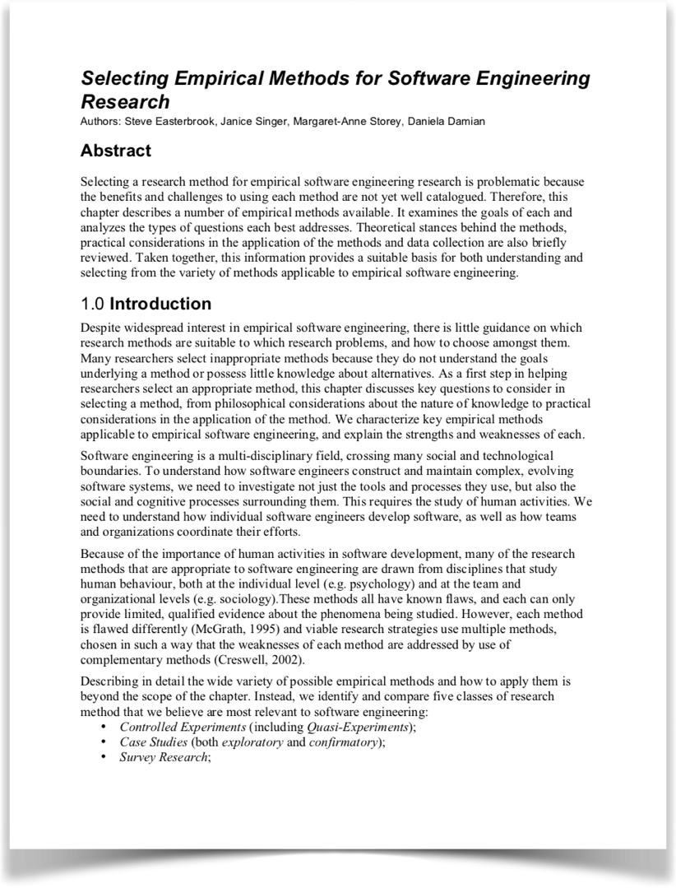

Not trivial, but possible: checklists
Good starting point
More advanced
Chapter 16 + Appendix
http://bit.ly/checklists-design_science

Slide 37


How to achieve scientific progress?
In step-wise iterations, with multiple methods (aka “research programme”)

Slide 38
Progress via multi-study approaches
1
Problem analysis
2
2
e.g. Systematic Mapping Study or Survey
Proposal new / adaptation existing technology
Replication
1
3
4
5
e.g. RE Improvement Approach
3
Validation of new technology in artificial setting
Replication
e.g. Controlled Experiment
4
Evaluation of new technology in realistic setting
e.g. Case Study
5
Large-scale evaluation
e.g. Field Study or longitudinal study

Slide 39
Theory Building in Software Engineering
Science and Theories in a Nutshell
… where we will briefly talk about the general notion of theories
State of Evidence in Software Engineering
… where we will see why theory building is so important to our field
Research Methods in Software Engineering
… where we will put research methods in a larger (philosophical) picture
Qualitative “vs” quantitative research
… where we will briefly discuss different research approaches

Slide 40
What is the difference between qualitative and quantitative research?
-- What do you think? --

Slide 41
Warning: EmSE emerges from natural science, thus, qualitative methods are often confronted with prejudice
“I prefer working with real data [not with qualitative data]”
— Anonymous ISERN member
“In contrast [to previous qualitative studies], this study attempts to obtain more scientific evidence in the form of objective, quantitative data.”
— Anonymous ESEM 2018 author
“With all due respect, DO NOT make such ridiculous claims that only quantitative studies are "scientific" and “objective" […]. There is NO more objectivity in numbers than there is in qualitative data. […] It is insulting and unnecessary and frankly naive to claim that because this study happens to use a bunch of numbers it is of better quality than qualitative studies”
— Anonymous ESEM 2018 reviewer

Slide 42
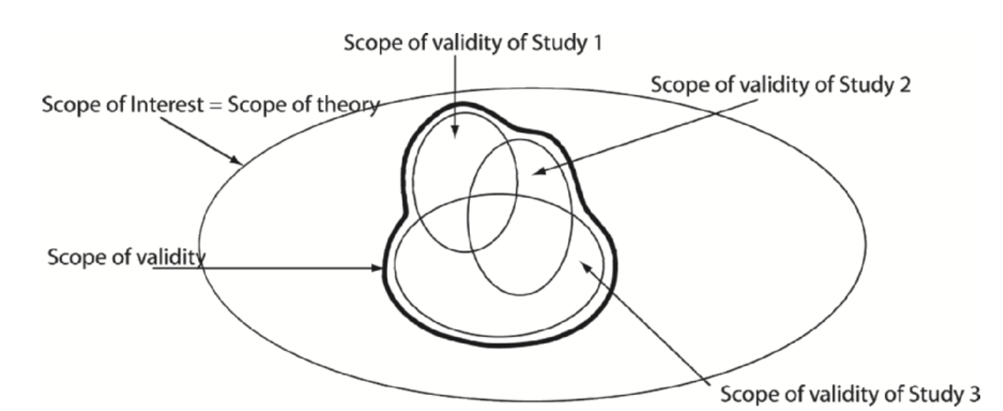
Postulate I Every research approach has a specific scope of validity only
Source: Sjøberg, D., Dybå, T., Anda, B., Hannay, J. Building Theories in Software Engineering, 2010.

Slide 43
Postulate II Scope of validity ≠ Degree of reality
Realistic environment
Replications
Survey Research
Case Study Research
Field Study Research
Simulation
Scope of validity*
Controlled (lab) Experiment
Replications
Artificial environment
* Extremely simplified view to orient discussions

Slide 44



Postulate III Different research methods complement each other in scaling up to practice
Focus of case studies
Similarity to population units
Street credibility
Realistic case
Scaling up to practice
Focus of (lab) experiments
Simple model
Lab credibility
Sample size
Small sample
Large sample
Focus of field studies and replications
Source: Wieringa R. Empirical Research Methods for Technology Validation: Scaling Up to Practice, 2013.

Slide 45
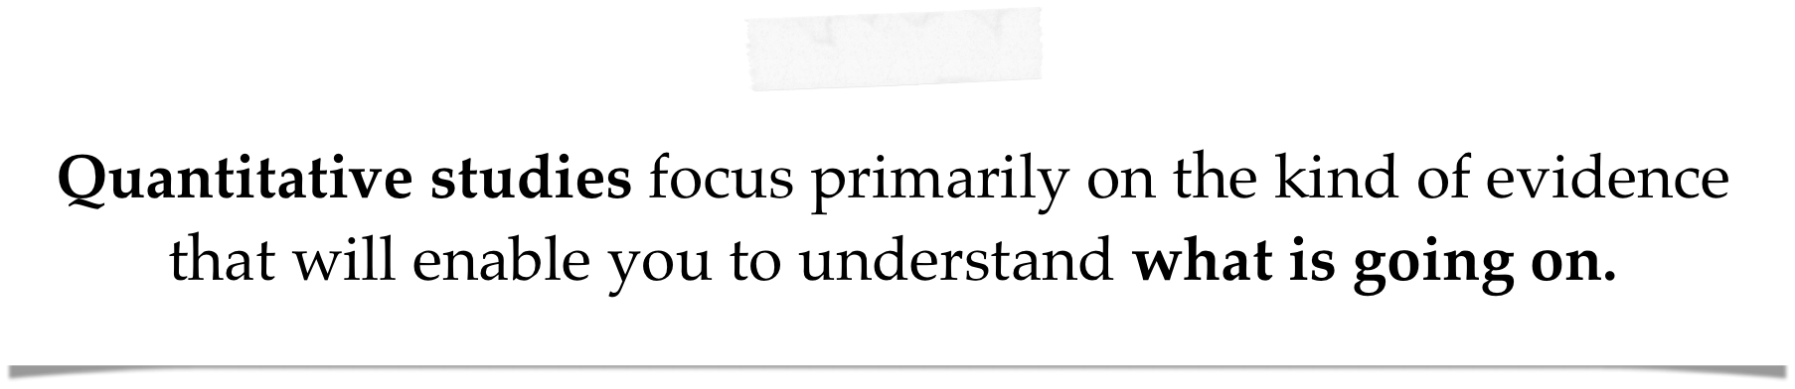

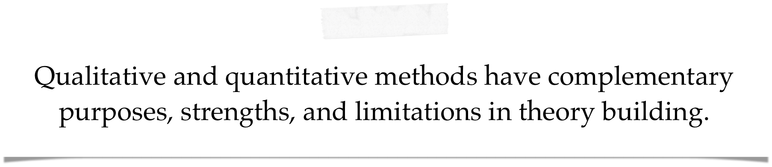
The essence

Slide 46
Two complementary approaches (+1)
Quantitative research: Describing events and finding causes to predict similar events in the future – “What?”-questions
(Typically) focus on what, how much, or how many
(Typically) in numerical forms
(Typically) descriptive purpose
Qualitative research: Understanding meaning [and purpose, reasoning, etc.] of a phenomenon for those involved – “So what?”-questions
(Typically) focus on why/meaning, and how people interpret their experiences
(Typically) in variety of non-numerical forms, like texts, diagrams, etc.
(Typically) exploratory or explanatory purpose
(Mix-method research)
Adopted from: Da Silva. Tutorial given at the Ibero-American Conference on Software Engineering, 2018 (Bogota, Colombia)

Slide 47
Two complementary approaches
“What?”-Questions
“So what?”-Questions
Descriptive & predictive purposes
Explanatory & exploratory purposes
Quantitative data
Qualitative data
Case study research
Survey research
(Quasi-) Controlled experiments
Action research
Ethnographic
studies

Slide 48
Qualitative “vs” quantitative research
* For all, you can add a “in tendency”
 | Quantitative research | Qualitative research
Goals | Description, control, prediction Hypothesis testing (typically) | Understanding, reasoning, explanations, descriptions, meaning (to subjects), discovery Hypothesis generation (typically)
Design characteristics | Predetermined, structured / fixed Deductive, statistical | Flexible, evolving, emergent Inductive, constant comparative
Samples | Large(r), random, representative | Small, non-random (sometimes even opportunistic), purposeful, theoretical
Data collection | Inanimate instruments (tests, surveys, questionnaires, etc.) | Researcher often primary instrument Interviews, observations, document analysis, …
Findings | Precise and statistical | Comprehensive, holistic, rich descriptions
Adopted from: Da Silva. Tutorial given at the Ibero-American Conference on Software Engineering, 2018 (Bogota, Colombia)

Slide 49
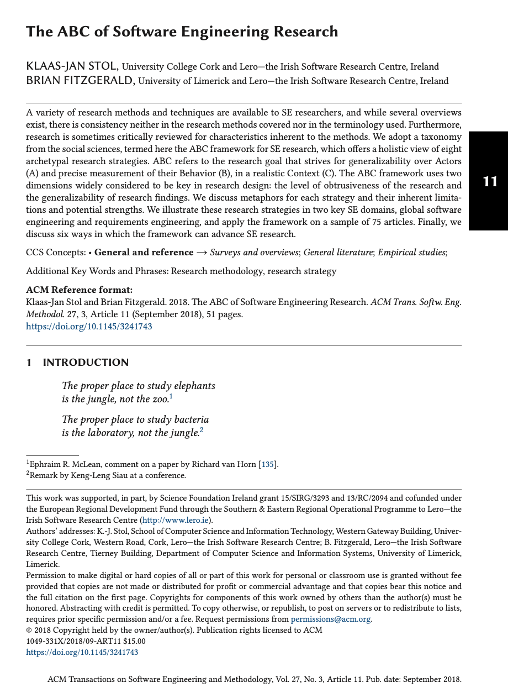
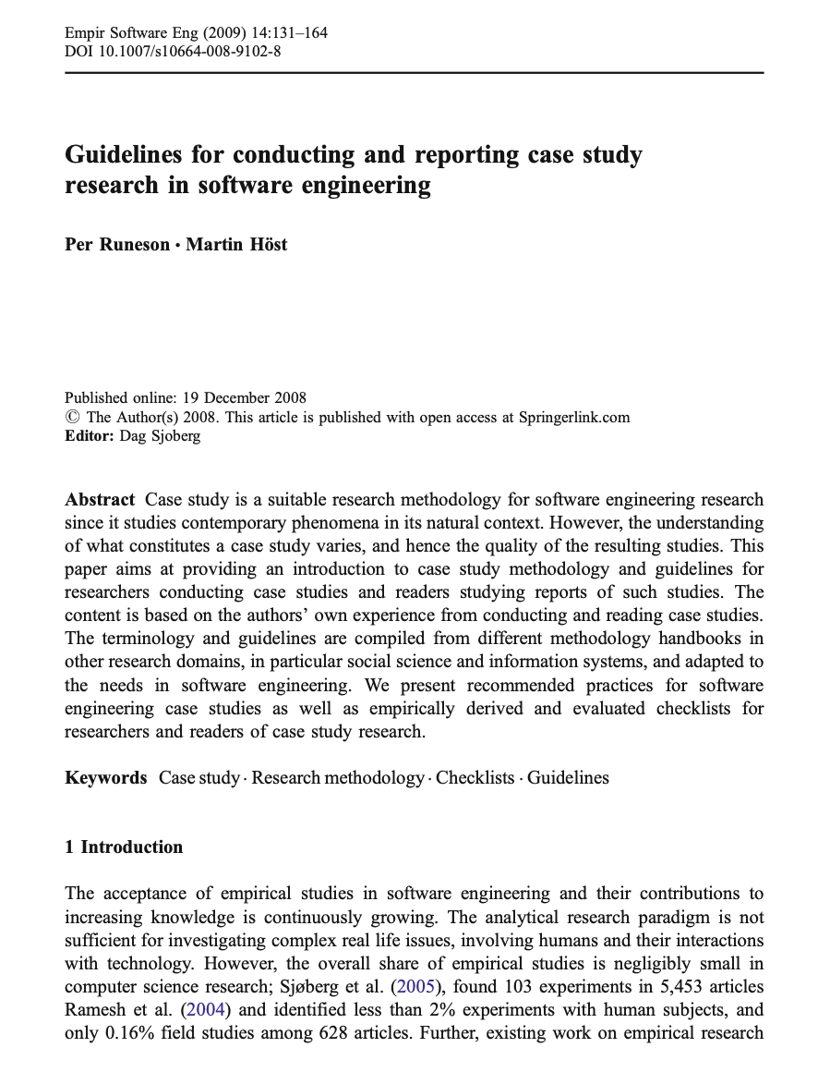
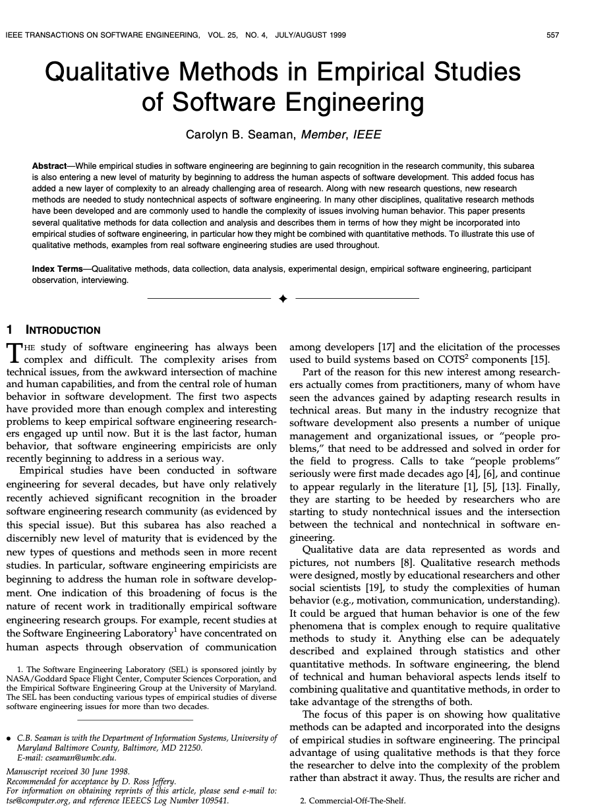
Further reading: Selected papers
Recommended starting point
Further reading on terminological demarcation and key characteristics of methods

Slide 50
Theory Building in Software Engineering
Science and Theories in a Nutshell
… where we will briefly talk about the general notion of theories
State of Evidence in Software Engineering
… where we will see why theory building is so important to our field
Research Methods in Software Engineering
… where we will put research methods in a larger (philosophical) picture
Qualitative “vs” quantitative research
… where we will briefly discuss different research approaches

Slide 51
Key Takeaways
Thank you!
Last but not least…
Empirical research is the backbone of every scientific discipline.
Let’s use the breakout sessions to jointly discuss research strategies, methods, and their (case-based) application in detail.
I am organising a summer school on human factors in software engineering (hfse.school). Interested? Approach me!
1
Theory building and evaluation allow us to move forward from paradigmatic stage of an engineering discipline to a scientific one.
Every research method has its place in a larger picture.
2
Qualitative and quantitative research have complementary purposes, strengths, and limitations in building and evaluating theories.

